Slide 1
Eagle Rocketry
Feed System Design Review
Fall 2025: Preliminary Design Review
Eagle Rocketry Team
UPDATE 2: 11/13/2025

Slide 2
Introduction

Slide 3
Feed System Role
Main Objective: Develop Cal State LA's first bi-propellant liquid rocket engine.
Our Goal: Design, assemble, and successfully test a pressurized Liquid Oxygen–Kerosene feed system for our eagle's rocket engine.
Responsibilities:
Design and Develop A Bi-propellant Feed System
Research & Source Components
Manufacture & Assemble Components
Design Propellant Pneumatic Pressurization Valves

Slide 4
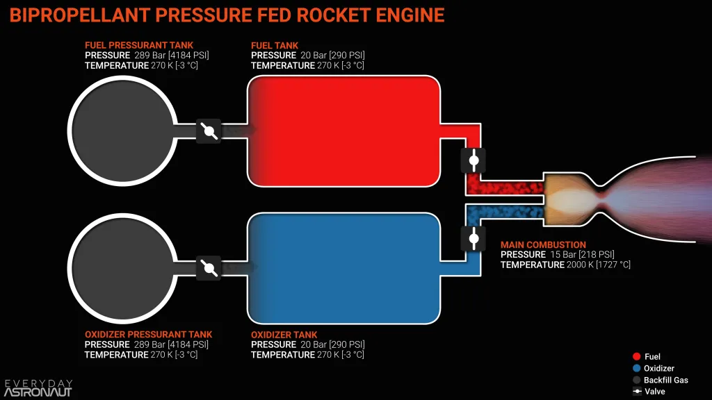
P&IDs – Rocket Feed Systems

Slide 5
Eagle Rocketry Design Parameters
Rocket engine parameters & fluid flow properties are to be considered when designing a bi-propellent liquid rocket engine
Engine Parameters
F_{Thrust} | 1000 | N
P_{Chamber} | 2.28E+6 | Pa
t_{Burn} | 10 | s
Propellant Properties
O/F_{O2(L)/RP-1} | 2
T_{O2(L)/RP-1} | 3252.57 | K
MW_{O2(L)/RP-1} | 20.674 | kg/k-mol
γ_{O2(L)/RP-1} | 1.1636 | J/kg-K
R_{O2(L)/RP-1} | 402.17 | J/kmol-K

Slide 6
RPA – Rocket Propulsion Analysis
RPA software was utilized to optimize propellant mixture ratios, chamber/nozzle design, and rocket engine performance. The values below are for the rocket design of choice
Parameter |  | Engine | Chamber | Units
Thrust | Sea Level | 996.7 | 996.7 | N
Specific Impulse | Sea Level | 2414.77 | 2414.77 | Ns/kg
Mass Flow Rate | Total | 0.4128 | 0.4128 | kg/s
Type | Engine | Chamber | Units
Oxidizer | 0.2752 | 0.2752 | kg/s
Fuel | 0.1376 | 0.1376 | kg/s

Slide 7
Propellant Fluid Properties
The following fluid properties for the fuel and oxidizer propellants are listed for analytical pressure drop calculations along the rocket feed system P&ID
RP-1 ‘Kerosene’
T_{RP-1} | 298.1 | K
P_{RP-1} | 101325 | Pa
ρ_{RP-1} | 790 | Kg/m^3
μ_{RP-1} | 0.001078 | Pa-s
Mass Weight | 1.46 | kg
Liquid Oxygen ‘O2(L)’
T_{O2(L)} | 90.2 | K
P_{O2(L)} | 101325 | Pa
Ρ_{O2(L)} | 1141.09 | Kg/m^3
μ_{O2(L)} | 0.000195 | Pa-s
Mass Weight | 2.92 | kg

Slide 8
Friction Major Pressure Loss Variables
The minor pressure loss calculations account for the piping from the propellant tank exit up to the injector entrance for 30 in. of pipe length
Fluid Properties: RP-1
Pipe: | ¼ in. Copper (Type K)
Q_{Fuel} | 1.74E-4 | m^3/s
Vel_{Fuel} | 5.5 | m/s
Re_{Fuel} | 25590.86
e/D_{Fuel} | 0.00024 | m
f_{Fuel} | 0.0249
△P_{Friction} | 3.58E+4 | Pa
Fluid Properties: O2(L)
Pipe: | ¼ in. Copper (Type K)
Q_{Oxidizer} | 2.41E-4 | m^3/s
Vel_{Oxidizer} | 7.61 | m/s
Re_{Oxidizer} | 283515.98
e/D_{oxidizer} | 0.00024 | m
f_{Oxidizer} | 0.0167
△P_{Friction} | 6.63E+4 | Pa

Slide 9
Friction Minor Pressure Loss Variables
The minor pressure loss calculations below account for the pipe fittings and components from the propellant tank exit up to the injector entrance.
Pipe Fittings: RP-1
K_{L1} | 0.5 | Contraction
K_{L2} | 0.5 | Ball Valve
K_{L3} | 0.35 | Pneumatic
K_{L4} | 1.08 | Check Valve
K_{L5} | 1.5 | Elbow
K_{L6} | 2 | Tee
K_{L7} | 1 | Entrance
△P_{K_L-Total} | 1.30E+5 | Pa
Pipe Fittings: O2(L)
K_{L1} | 0.5 | Contraction
K_{L2} | 0.5 | Ball Valve
K_{L3} | 0.35 | Pneumatic
K_{L4} | 1.08 | Check Valve
K_{L5} | 1.5 | Elbow
K_{L6} | 2 | Tee
K_{L7} | 1 | Entrance
△P_{K_L-Total} | 3.62E+5 | Pa

Slide 10
Orifice Restriction & Pressure Head Loss
Fluid properties entering the rocket engine are affected by the orifice entrance at the combustion chamber
Fluid properties and pressure is affected due to the height difference in the P&ID
RP-1 ‘Kerosene’
C_{d} | 0.75
△P_{K_L-Total} | 2.12E+4 | Pa
Liquid Oxygen ‘O2(L)’
C_{d} | 0.75
△P_{K_L-Total} | 5.88E+4 | Pa
RP-1 ‘Kerosene’
Total Height | 0.127 | m
△P_{Hydrostatic} | 984.24 | Pa
Liquid Oxygen ‘O2(L)’
Total Height | 0.127 | m
△P_{Hydrostatic} | 1421.65 | Pa

Slide 11
Overview

Slide 12
High-Level Overview
Nitrogen Pressurant Sub-system
Stores and supplies high-pressure nitrogen gas used to maintain tank and feed-line pressures in liquid propellent rocket engines.
PT
PT
S
To Distribution
2400 psi
~??? psi
S

Slide 13
High-Level Overview
Nitrogen Distribution & Work Gas Sub-system
A network that distributes, regulates, and controls the nitrogen gas utilized for all pneumatic and pressurization tasks.
To Fuel
PT
PT
From Pressurant
150psi
To Oxidizer

Slide 14
High-Level Overview
Fuel & Oxidizer Tank Sub-system
Isolates and controls the pressurized gas and delivers the propellants into the combustion chamber
PT
To Chamber
P
Fuel/Ox
P
TC
Only present on fuel side
S
S
3x For Oxidizer
S
From Distribution
From Distribution

Slide 15
Full Propellant Feed System
PT
P
Fuel
500 PSI
P
S
TC
S
S
PT
PT
PT
PT
TC
PT
TC
Chamber
2400 psi
S
~850 PSI
PT
150 PSI
PT
TC
S
TC
Piping & Instrumentation Diagram
Nitrogen Pressuring System
Gas Distribution System
Fuel/Oxidizer Systems
S
S
S
TC
TC
TC
P
Oxidizer
550 PSI
P
PT

Slide 16
Components

Slide 17
Propellant Tanks - Design Requirements
Propellant Tanks
Type | Design Requirement | Units
Diameter NPT | ¼ | In.
Pressure | 2000 | PSI
Temperature | -4 to 302 | F

Slide 18
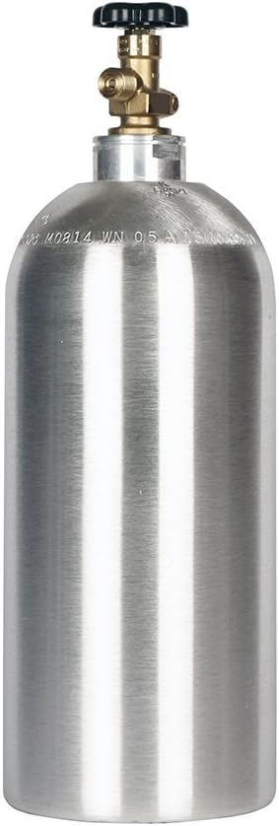
Propellant Tanks – Final Design Choices
Propellant Tanks
Type | Design Choice | Units
Diameter NPT | ¼ | In.
Pressure | 2000 | PSI
Temperature | -4 to 302 | F

Slide 19
Manual Ball Valves - Design Requirements
Manual Ball Valves
Type | Design Requirement | Units
Diameter NPT | ¼ | In.
Pressure | 2000 | PSI
Temperature | -4 to 302 | F

Slide 20
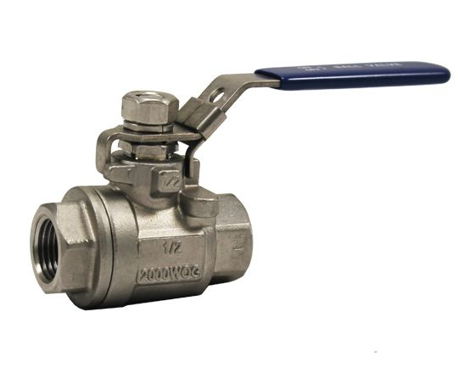
Manual Ball Valves – Final Design Choices
Manual Ball Valves
Type | Design Choice | Units
Diameter NPT | ¼ | In.
Pressure | 2000 | PSI
Temperature | -4 to 302 | F

Slide 21
Relief Valves - Design Requirements
Relief Valves
Type | Design Requirement | Units
Diameter NPT | ¼ | In.
Pressure | 2000 | PSI
Temperature | -4 to 302 | F

Slide 22
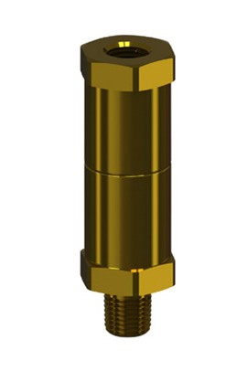
Relief Valves – Final Design Choices
Relief Valves
Type | Design Choice | Units
Diameter NPT | ¼ | In.
Pressure | 2000 | PSI
Temperature | -4 to 302 | F

Slide 23
Check Valves - Design Requirements
Check Valves
Type | Design Requirement | Units
Diameter NPT | ¼ | In.
Pressure | 2000 | PSI
Temperature | -4 to 302 | F

Slide 24
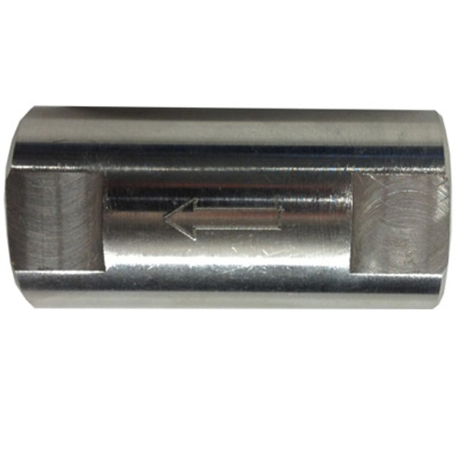
Check Valves - Design Choices
Check Valves
Type | Design Choice | Units
Diameter NPT | ¼ | In.
Pressure | 2000 | PSI
Temperature | -4 to 302 | F

Slide 25
Pressure Gages - Design Requirements
Pressure Gauges
Type | Design Requirement | Units
Diameter NPT | ¼ | In.
Pressure | 2000 | PSI
Temperature | -4 to 302 | F

Slide 26
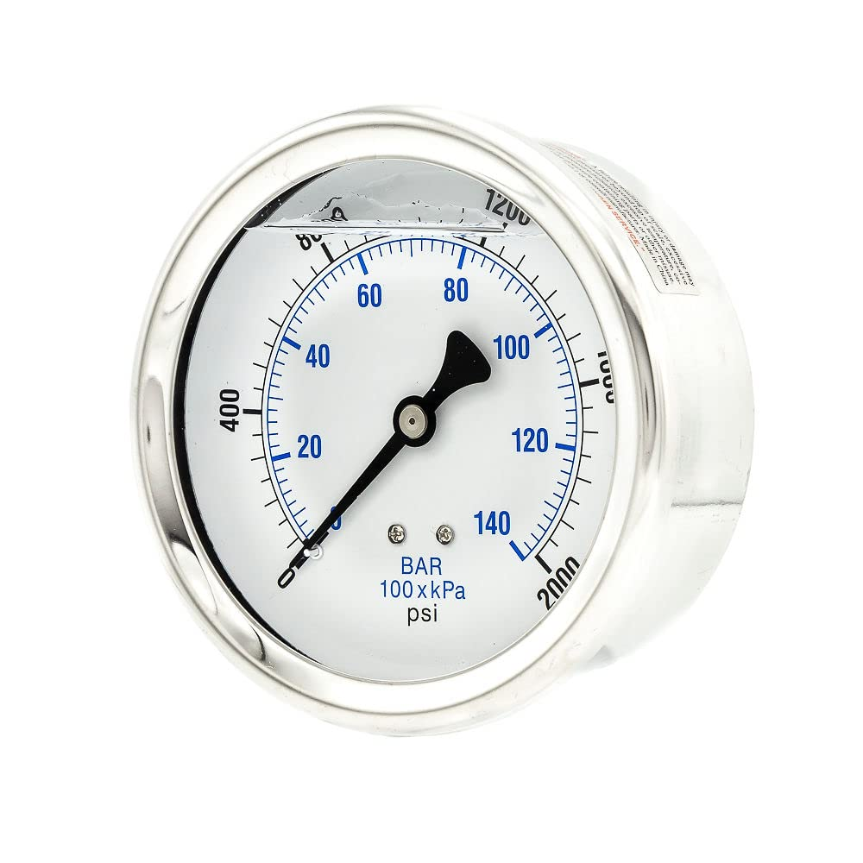
Pressure Gages - Design Choices
Pressure Gauges
Type | Design Choice | Units
Diameter NPT | ¼ | In.
Pressure | 2000 | PSI
Temperature | -4 to 302 | F

Slide 27
Pressure Transducers - Design Requirements
Pressure Transducers
Type | Design Requirement | Units
Diameter NPT | ¼ | In.
Pressure | 2000 | PSI
Temperature | -4 to 302 | F

Slide 28
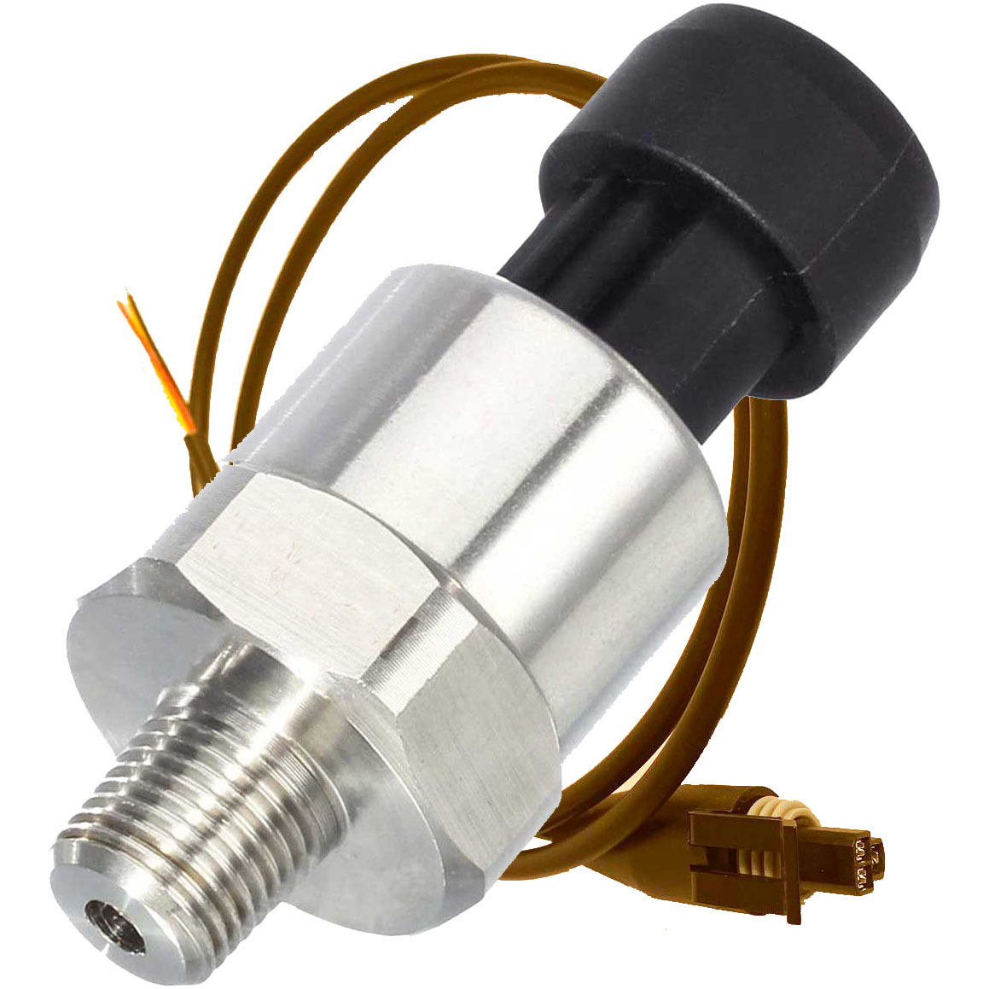
Pressure Transducers - Design Choices
Pressure Transducers
Type | Design Choice | Units
Diameter NPT | ¼ | In.
Pressure | 2000 | PSI
Temperature | -4 to 302 | F

Slide 29
Conclusion

